Slide 1


THE CHAO PHRAYA
EXPRESS BOAT SERVICE
COMMUTER FERRY FOR 200 PASSENGERS
SYED MARZAN UL HASAN
FACULTY ADVISOR: PROF. ANDRE HAGE

Slide 2
CONTENTS
DESIGN CHALLENGES
MAJOR CONSIDERATIONS
SOLUTIONS
MEASURES TO OVERCOME THE DIFFICULTIES

Slide 3
DESIGN CHALLENGES

Slide 4
MAJOR
CONSIDERATIONS
LOCALIZED SOLUTIONS
Acceptable by Owners, Operators and Passengers
Easier to implement
Matched to local operating conditions
INTEGRATED SAFETY
In-built safety features ensures that the vessel operates safely
Easy handling in the event of emergencies
OPERATIONAL REQUIREMENTS
Must meet or exceed the minimum operational requirements.
Ensure economic and stress free lifespan

Slide 5
MAJOR SOLUTIONS

Slide 6
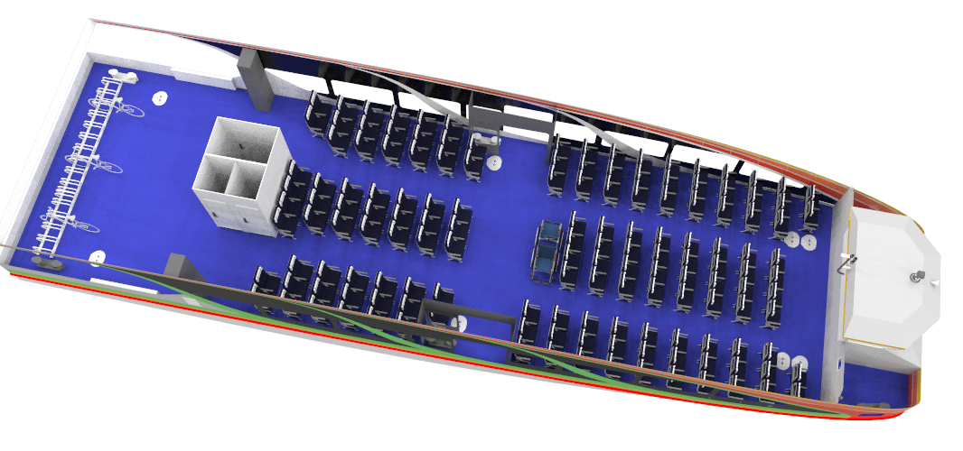
SPACE ALLOCATION
Long haul passengers and tourist at front where they get best views
Short distance commuters at back with greater movable areas and rapid on-off access
Elderly, people with reduced mobility, pregnant women, and person with small children and strollers are placed near to doorways for easier reach

Slide 7
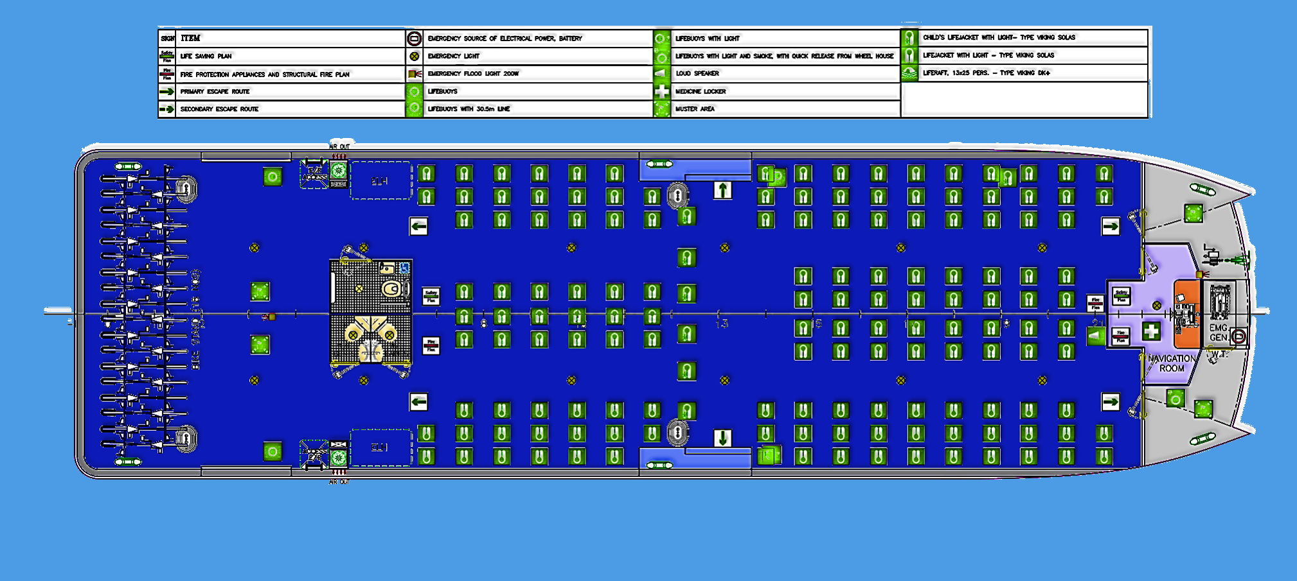
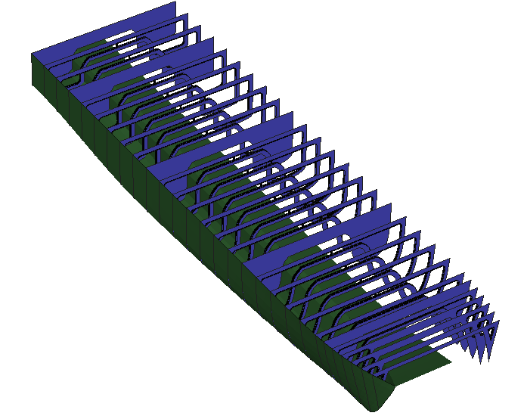
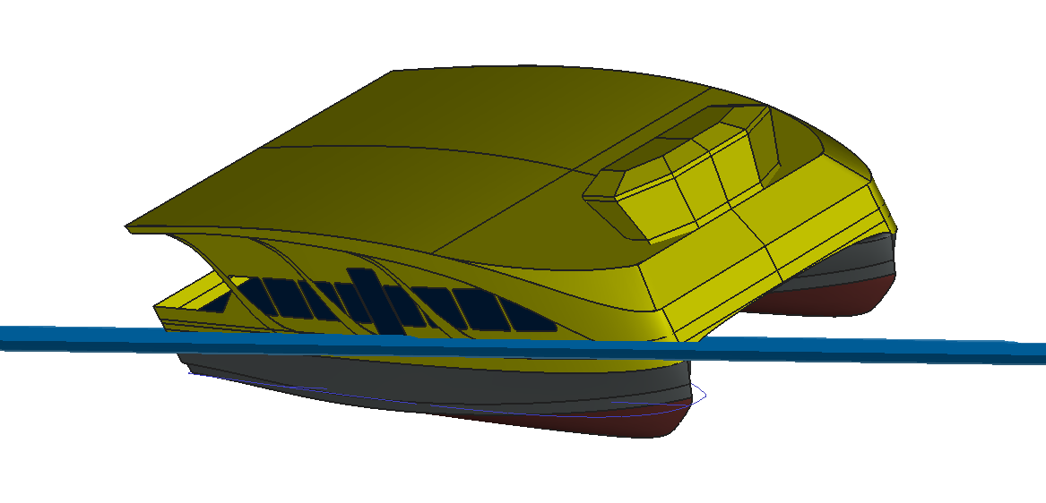
INTEGRATED SAFETY
Design ensuring a safe and comfortable stay. Adequate Life saving appliances .
Catamaran Hull complying structural requirements.
Adequate Intact and Damage stability including wind heel and passenger crowding on one side.
Fire safety features, insulation from machinery spaces, fire-hoses, audio-visual alarms and signals. Emergency fire pump and generator for additional safety.
Marshalling and rescue area at aft in case of emergency.
Foldable ramps offering quick but safe in and out movement of passengers.

Slide 8
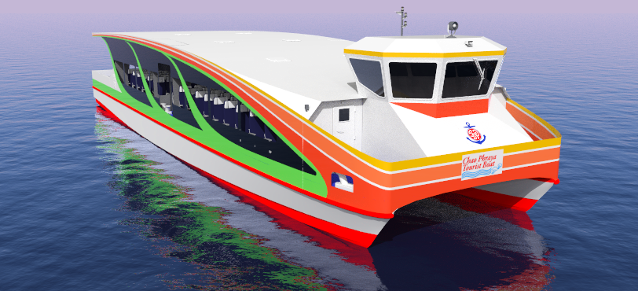
OPERATIONAL REQUIREMENTS
All-round visibility from raised navigation room.
Signal arrangements in mast allowing night operation.
Quick retractable mast ensures air draft compliance for passing under low bridges

Slide 9
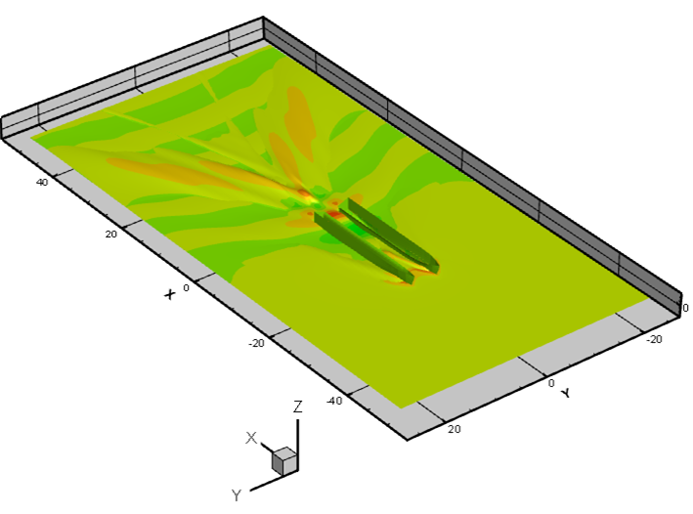
ENVIRONMENT
Low water-wake and wash.
Optimized performance, reduced fuel consumption, lower exhaust and water pollution for environmental sustainability.
Tourist and commuter awareness to avoid further degradation and promoting restoration of the thriving water way.

Slide 10
THANK YOU!
SAFE AND AFFORDABLE – CHAO PHRAYA EXPRESS BOAT

